Slide 1
The ACMG/AMP/CAP/ClinGen
Draft Standards for Sequence Variant Classification
Steven Harrison, PhD FACMG
Genomic Science Director, Ambry Genetics
On behalf of ACMG/AMP/CAP/ClinGen SVC Working Group

Slide 2

ACMG/AMP/CAP/ClinGen Working Group
Current WG Membership:
Les Biesecker, MD (Co-Chair; NHGRI/NIH) | Alicia Byrne, PhD (Broad Institute) | Anne O’Donnell-Luria, MD (Boston Children’s Hospital)
Steven Harrison, PhD (Co-Chair; Ambry) | Elizabeth Chao, MD (UC Irvine) | Sharon Plon, MD, PhD (Baylor College of Medicine)
Ahmad Abou Tayoun, PhD (Al Jalila Children's) | Julie Gastier-Foster, PhD (Texas Children's; AMP Rep) | Heidi Rehm, PhD (Massachusetts General Hospital)
Jonathan Berg, MD, PhD (UNC) | Izabela Karbassi, PhD (Quest Diagnostics) | Lisa Vincent, PhD (Natera)
David Bick, MD (Genomics England) | Ann Moyer, MD, PhD (Mayo Clinic; CAP Rep) | Nicky Whiffin, PhD (University of Oxford)
Past WG Members:
Sian Ellard, PhD, FRCPath (University of Exeter) | Heather McLaughlin, PhD (Pharming) | Sue Richards, PhD (OHSU)

Slide 3
Standards for Sequence Variant and CNV Classification
SVC v1
Kazazian et al 2002
SVC v2
Richards et al. 2008
CNV 2011
SVC v3
Richards et al. 2015
Harmonized terms
CNV 2020
SVC versioning is being applied retrospectively
Riggs et al. 2020
SVC v4.0
2025?
(in development)
Points based
Bayesian
CNV 202?
Further harmonization in the future around clinical data
In development

Slide 4
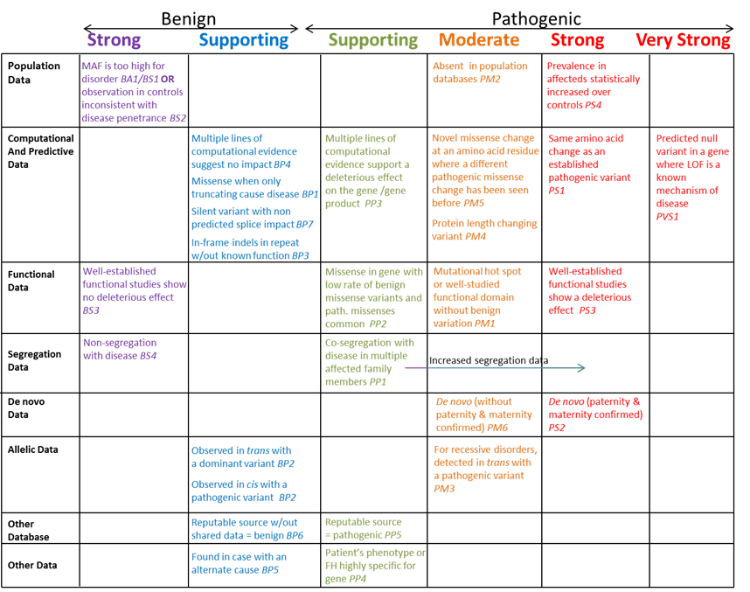
Goals of SVC v4.0
Revise current standards to address:
  appropriateness of criteria (PP5/BP6, PM2)
  ambiguities in the application of criteria
  strength assigned to criteria,
individually and in combination
  avoidance of double-counting
  guidance for combining pathogenic and benign criteria
Incorporate updates from ClinGen working groups, and develop mechanism for ongoing updates
Where possible, establish more quantitative parameters

Slide 5
Big Picture - v3 (Richards et al) versus v4
Incorporate Gene Disease Validity
Points based system
  More granular, improving calibration
  Allows combining of positive and negative evidence
Evidence codes
Decision trees
Evidence types - some new, some eliminated, many altered weights

Slide 6
Incorporating Gene-Disease Validity into Variant Classification
Variant Classification G-D validity | PATHOGENIC | LIKELY PATHOGENIC | VUS | LIKELY BENIGN | BENIGN
DEFINITIVE & STRONG | Allowed | Allowed | Allowed | Allowed | Allowed
MODERATE | Not Allowed (limit to LP) | Allowed | Allowed | Allowed | Allowed
LIMITED | Not allowed (limit to VUS) | Not allowed (limit to VUS) | Allowed | Allowed | Allowed
LESS THAN LIMITED (no evidence) | Variant in Gene of Uncertain Significance
DISPUTED / REFUTED FOR DISEASE | Do not report

Slide 7
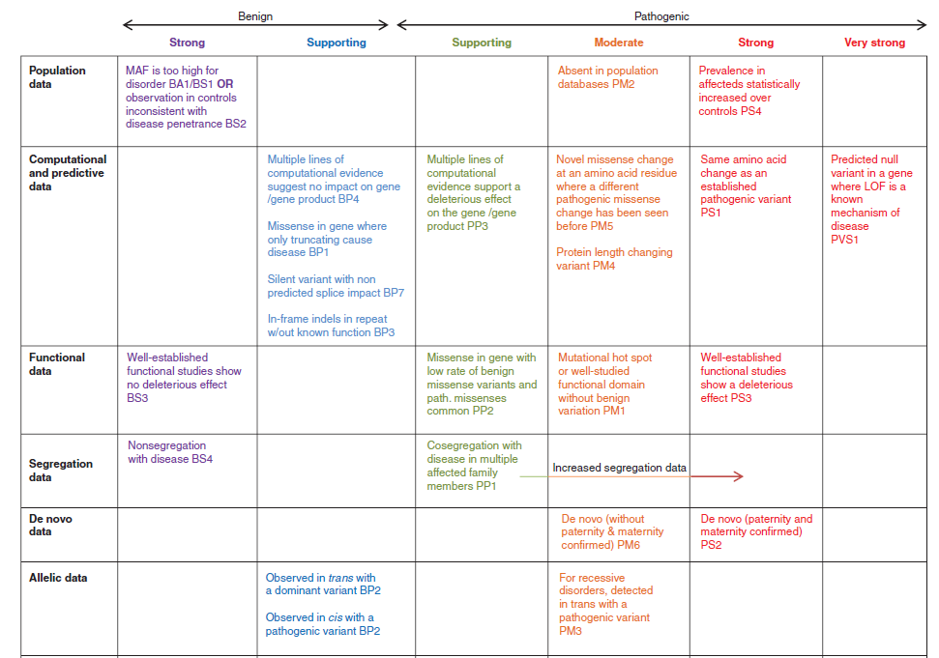
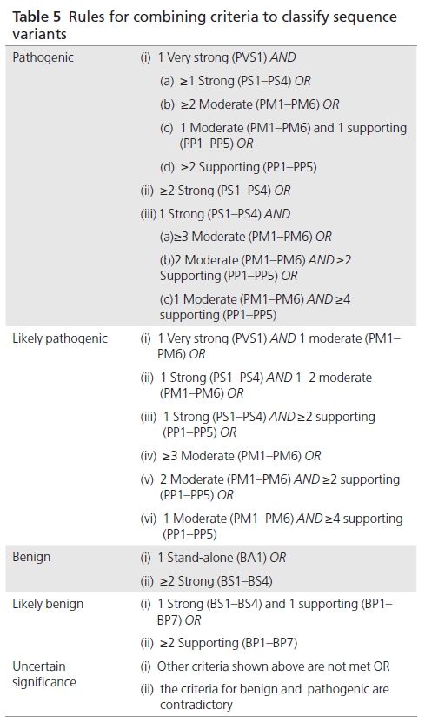
SVC v3 used strength categories
v3 used categories of evidence strength (Strong, Moderate, etc) and then had combining rules to determine the classification level.
Not all possible scenarios are accounted for in these combining rules (such as 2 Very Strong or 1 Very Strong + 1 Supporting)
Many VCEPs override scenarios with conflicting evidence

Slide 8
Bayesian ‘points’ adaptation of SVC v3 = v4 foundation
1%
10%
90%
99%
≤ -4
0 to 5
-3 to -1
6 to 9
≥10
Benign
Likely
Benign
Uncertain significance
Likely
Pathogenic
Pathogenic
ACMG 2015 Evidence Strength | Odds Path (LR+) | Point Adaption
Benign - Strong | 1:18.7 | -4
Benign - Supporting | 1:2.08 | -1
Indeterminate | - | 0
Pathogenic - Supporting | 2.08:1 | +1
Pathogenic - Moderate | 4.33:1 | +2
Pathogenic - Strong | 18.7:1 | +4
Pathogenic – Very Strong | 350:1 | +8
Tavtigian et al 2020

Slide 9
Bayesian ‘points’ adaptation of SVC v3 = v4 foundation
1%
10%
90%
99%
≤ -4
0 to 5
-3 to -1
6 to 9
≥10
Benign
Likely
Benign
Uncertain significance
Likely
Pathogenic
Pathogenic
Our starting point for most lines of evidence is the point equivalent in v3 (i.e. Moderate = +2 pts)
If a curator ONLY had this piece of evidence, what should the classification be?…and how much additional evidence would be needed to move the variant up or down

Slide 10
Bayesian ‘points’ adaptation of SVC v3 = v4 foundation
1%
10%
90%
99%
≤ -4
0 to 5
-3 to -1
6 to 9
≥10
Benign
Likely
Benign
Uncertain significance
Likely
Pathogenic
Pathogenic
A few modifications on the LB/B side….
Richards et al did not define boundaries for P and B
  Bayesian framework assumed B = 0.1% probability of causing disease
For v4, we are using a 1% threshold for B
We maintaining the 10% threshold for LB, but lowering the relative weight needed to reach LB

Slide 11
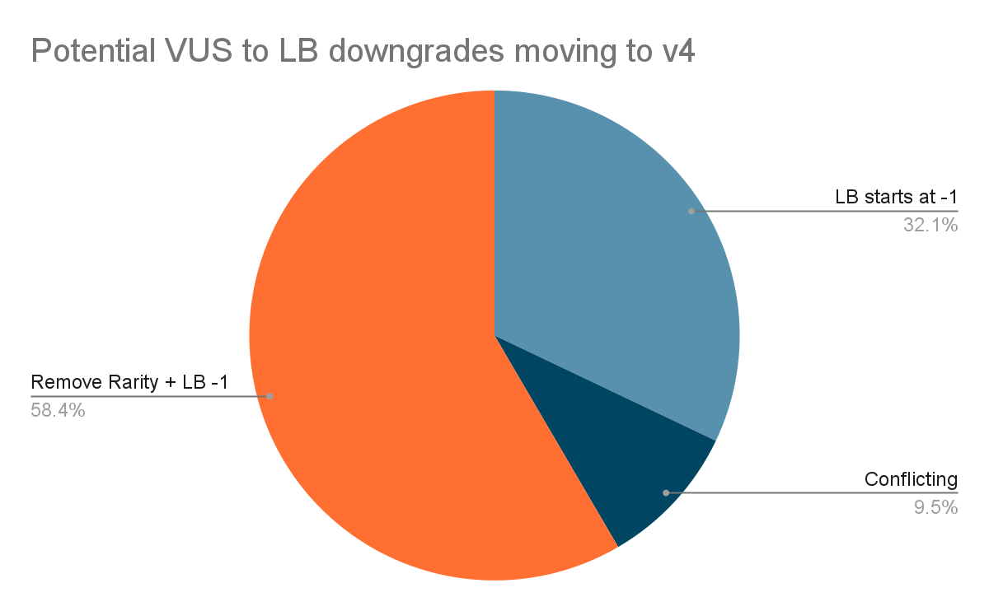
Impact on Current VCEP VUS Classifications
Currently 3308 VUS classifications from VCEPS
25% of VUS would change classifications with v4 based on points approach (not considering new evidence)
7 VUS to LP/P
  all due to scenarios not present in v3
820 VUS to LB/B
  Pie chart

Slide 12
VUS sub-classification options
“Low”
0 - 1 pts
“Mid”
2 - 3 pts
“High”
4 - 5pts
1%
10%
90%
99%
≤ -4
0 to 5
-3 to -1
6 to 9
≥10
Benign
Likely
Benign
Uncertain significance
Likely
Pathogenic
Pathogenic
A points-based classification framework allows for subclassification of VUS
An ACMG VUS committee is working to make general recommendations around reporting and may develop guidance about when to use VUS subcategories

Slide 13
SVC v3.0 vs. SVC v4.0
Both versions consider multiple, individual lines of evidence, and combine them to arrive at the final classification of a variant
The lines of evidence (i.e., concepts considered), mostly the same - creating few new types of evidence
  Change evidence code names
The structure for how that evidence is considered, both individually and in aggregate, will change

Slide 14
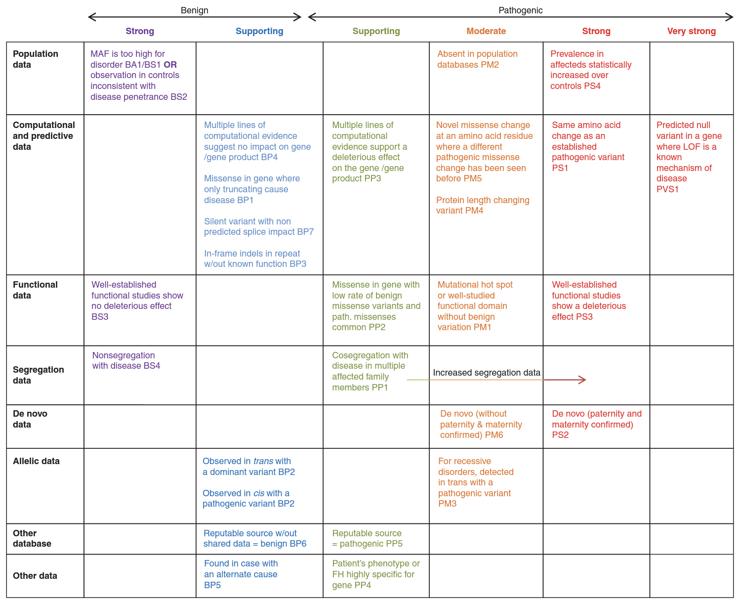
SVC v3 - Table conveys evidence concept that strength-based code represents
v3 Problem: Doesn’t convey that some codes are related across the defined concepts…
nor provide a framework to restrict combined use of related codes across concepts
> Current work around is ‘self’ imposed restrictions for combining

Slide 15
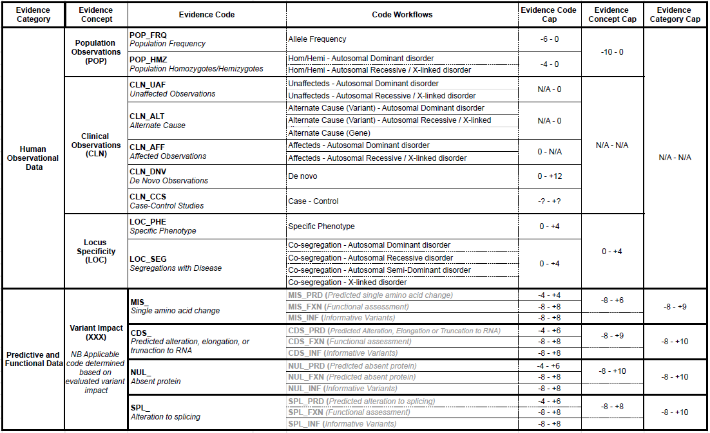
SVC v4 – DRAFT Hierarchical structure of evidence

Slide 16
SVC v4 - Codes defined based on evidence concept
v4 Solution: Codes defined to represent discrete lines of evidence
Labels given to v4 codes do not match v3 codes
* Labels given to codes may still change, but
the defined line of evidence they represent will not

Slide 17
SVC v4 - Code strength informed by specific scenario
v4 Solution:
Codes have no inherent strength, but do have a defined allowable range
* Strength ranges are still in development
Strength will be a continuous, Bayesian point-based scale, not discrete buckets
Applicable strength determined from code-specific table/workflow

Slide 18
SVC v4 - HIERARCHICAL structure means codes combined proportionally to determine classification
v4 Solution: Hierarchical framework allows evidence to be assessed individually, and related/overlapping evidence to be recognized and considered in aggregate

Slide 19
SVC v4 - Hierarchical structure of evidence
v4 Solution: Framework structured as:
Evidence Codes (and code components)
‘Discrete lines of evidence, assessed individually’
Strength determined using code-specific tables/flowcharts

Slide 20
SVC v4 - Hierarchical structure of evidence
v4 Solution: Framework structured as:
Evidence Concepts
‘Groupings of related codes, allowing aggregate assessment’
Strength determined from constituent codes
Maximum value ‘capped’ to consider overlapping evidence

Slide 21
SVC v4 - Hierarchical structure of evidence
v4 Solution: Framework structured as:
Evidence Categories
‘Groupings of related concepts, allowing aggregate assessment’
Strength determined from constituent concepts
Maximum value ‘capped’ to consider overlapping evidence

Slide 22
SVC v4 - Hierarchical structure of evidence
Four “root” codes:
POP_
CLN_
LOC_
And then one code from Variant Impact..
MIS_
CDS_
NUL_
SPL_

Slide 23
SVC v4 - Hierarchical structure of evidence
Option 1 – Just Root Codes:
POP_0
CLN_+6
LOC_+2
NUL_+8
Option 2 – Root and Granular codes:
POP_0 (POP_FRQ_0)
CLN_+6 (CLN_AFF_+2; CLN_DNV_+4)
LOC_+2 (LOC_PHE_+1; LOC_SEG_+1)
NUL_+8 (NUL_PRD_+6; NUL_INF_+2)

Slide 24
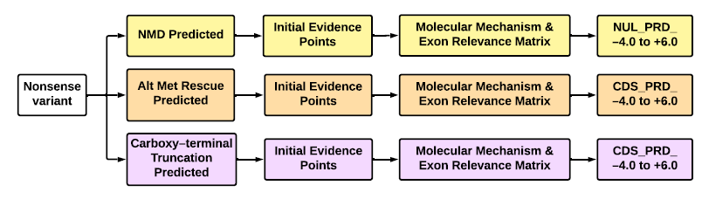
v3 framework versus v4 framework
v3 is designed with different evidence types that are Met or Not Met
v4 is designed more as a “curation SOP” with detailed decision trees that are meant to mimic the steps a curator follows when looking at that type of evidence

Slide 25
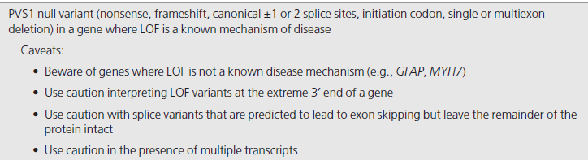
Nonsense Variant in v3 framework
Caveats and considerations are provided but no instructions on what to do with this information or how to assess it

Slide 26
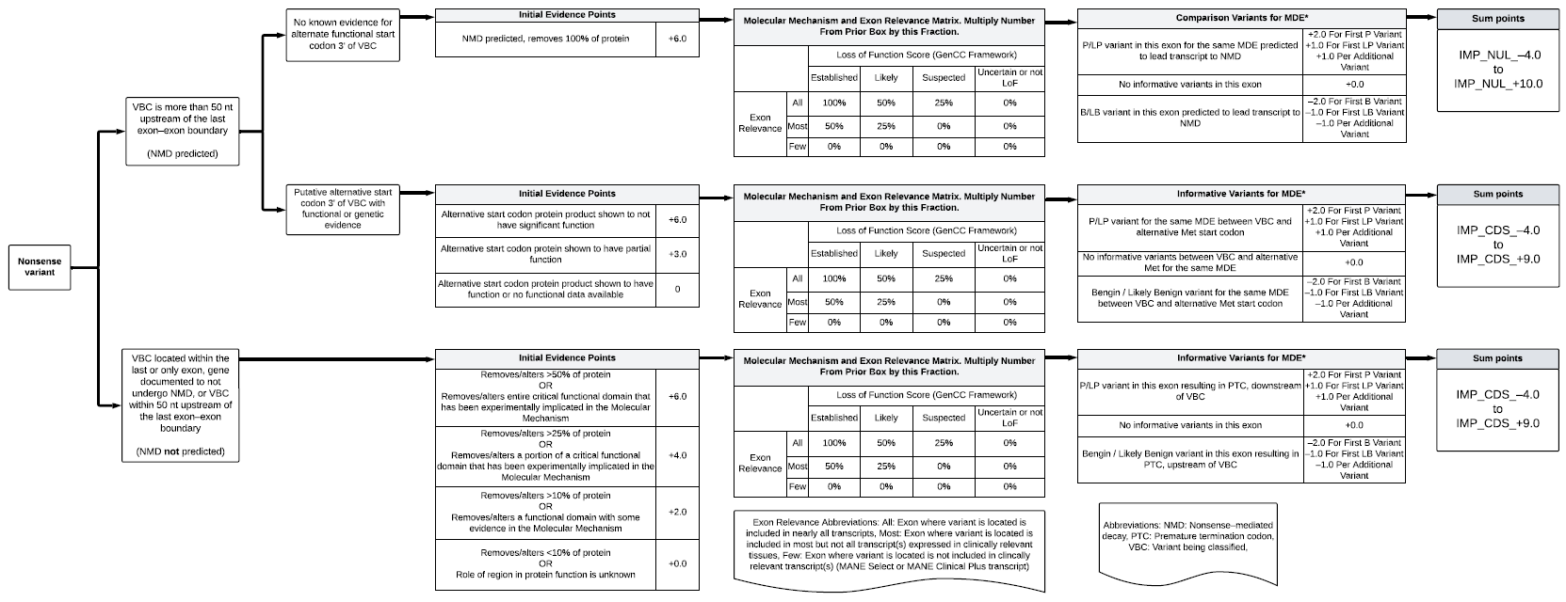
Nonsense Variant in v4 framework

Slide 27
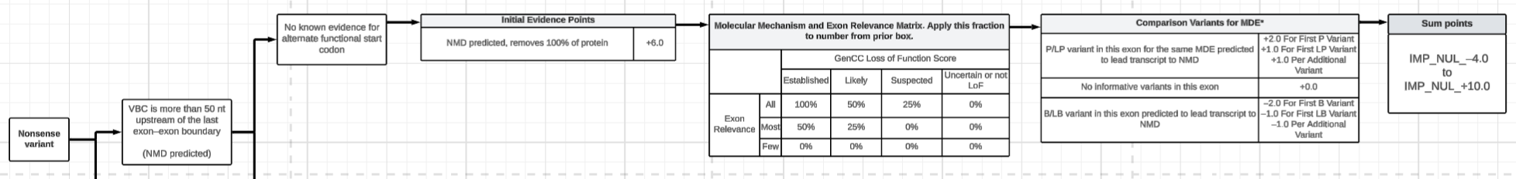
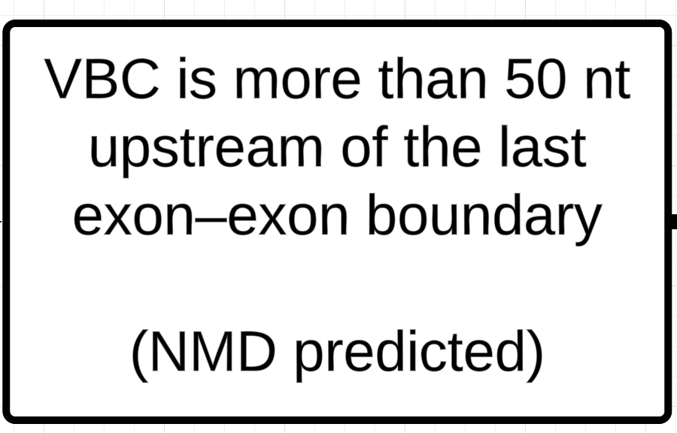
Nonsense Variant in v4 framework

Slide 28
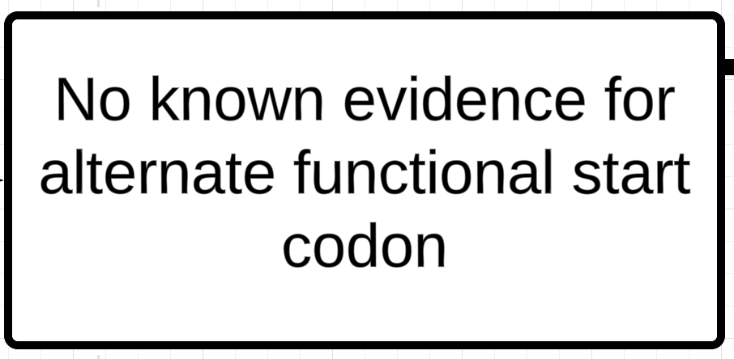
Nonsense Variant in v4 framework

Slide 29
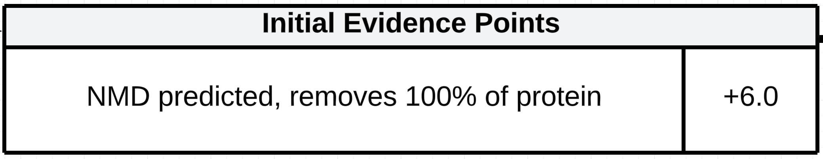
Nonsense Variant in v4 framework

Slide 30
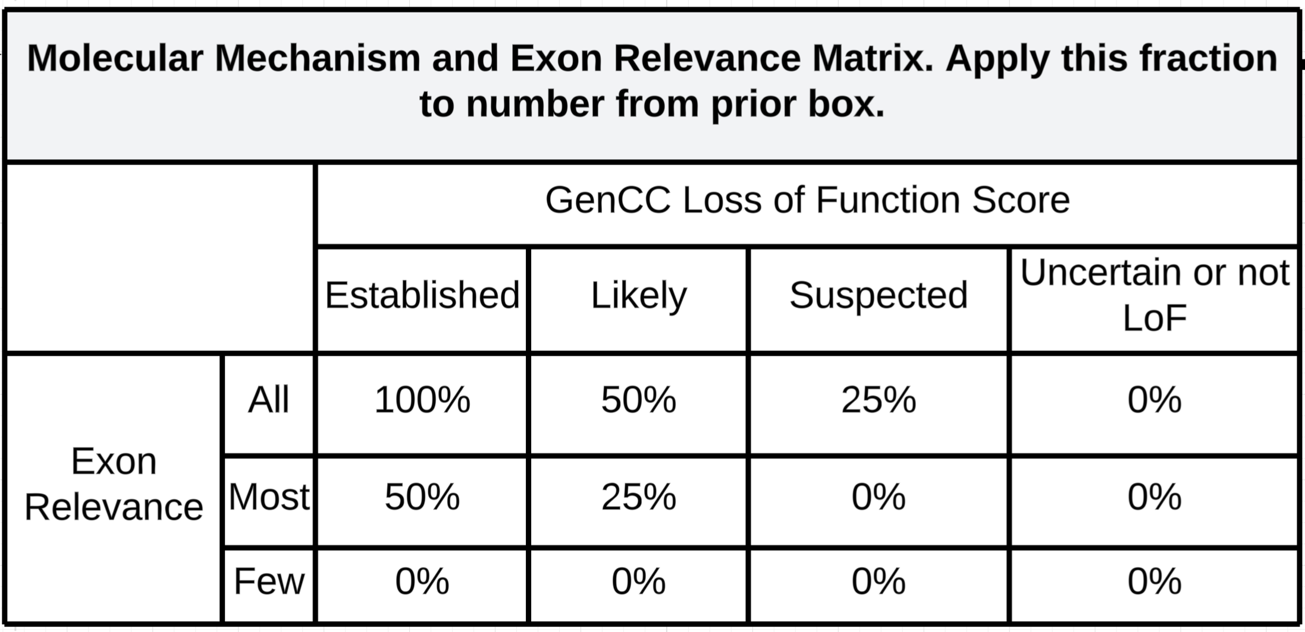
Nonsense Variant in v4 framework
Assess LoF as a mechanism and transcript data - as suggested in v3

Slide 31
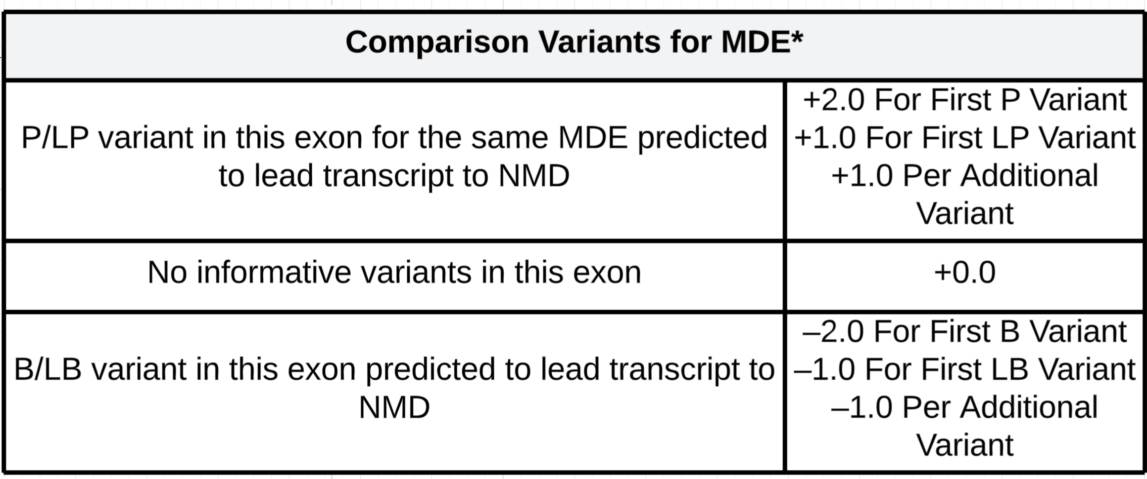
Nonsense Variant in v4 framework
Incorporates evidence from other LoF variants in this exon (P/LP and LB/B) - a concept not present in v3

Slide 32
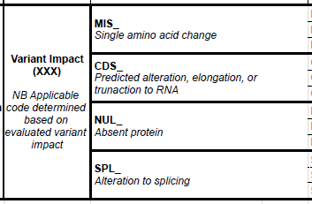
Decision Trees for Variant Types
Variant type
Assess predictive data
(NMD, splicing prediction, missense prediction, etc.)
Assess region information
(Impact on critical function domain and/or size of impact)
Assess disease mechanism & exon relevance
(Is it LoF? Is the exon in all clinically relevant transcripts?)
Assess informative variants
(Other variants in the same codon as VBC or similar impact as VBC)
End point Variant Impact Code
Decision trees help inform which impact has most supporting evidence

Slide 33
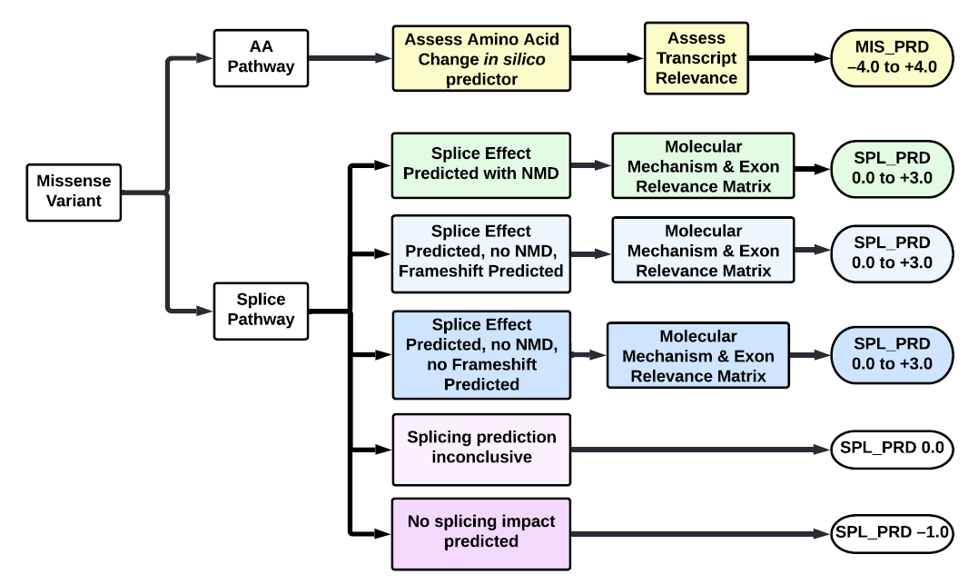
Missense Variant Decision Tree
After assessing both possible mechanisms, the curator applies the evidence & code that provides the most pathogenic evidence.
If a missense variant had more evidence supporting a splicing impact vs the amino acid change the SPL_ code would be applied instead of MIS_

Slide 34
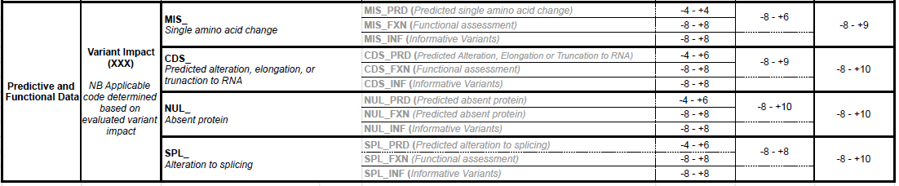
Predictive + Functional
v4 will recommend a point ceiling for predictive (PRD) and functional (FXN)

Slide 35
SVC v4 – Human Observational Data

Slide 36
CLN_AFF (Case Counting in v4)
Phenotype Consistency | Points per proband
 | Monoallelic Disorder | Biallelic Disorder
 |  | VBC is confirmed in trans with a P/LP variant | VBC is assumed* in trans with a P/LP variant | VBC is confirmed in trans with a VUS** variant | VBC is homozygous*** or hemizygous
Phenotype SPECIFIC for gene and all relevant genes for disorder tested, with no other variant of interest | +1 point | +2 point | +1.5 point | +1.0 point | +1.0 point
Phenotype SPECIFIC for gene but not all relevant genes for disorder tested, and/or more than one variant of interest | +0.5 point | +1 point | +0.75 point | +0.5 point | +0.5 point
Phenotype CONSISTENT with gene and all relevant genes for disorder tested, with no other variant of interest | +0.5 point | +1 point | +0.75 point | +0.5 point | +0.5 point
Phenotype CONSISTENT with gene but not all relevant genes for disorder tested, and/or more than one variant of interest | +0.25 point | +0.5 point | +0.25 point | +0.25 point | +0.25 point
Phenotype not consistent with gene (consider scoring individual under OBS_UAF) | +0 point | +0 point | +0 point | +0 point | +0 point
Utilizing categories of Phenotypic Consistency to help increase consistency in application of proband points

Slide 37
CLN_DNV (De Novo Case Counting in v4)
Phenotype Consistency | Points per proband
 | de novo with confirmed parental relationships | de novo with unconfirmed parental relationships
Phenotype SPECIFIC for gene and all relevant genes for disorder tested | +3 point | +1 point
Phenotype SPECIFIC for gene but not all relevant genes for disorder tested | +2 point | +0.5 points
Phenotype CONSISTENT with gene and all relevant genes for disorder tested | +2 point | +0.5 points
Phenotype CONSISTENT with gene but not all relevant genes for disorder tested | +1 point | +0.25 points
Phenotype not consistent with gene (consider scoring individual under OBS_UAF) | +0 point | +0 point
Same categories of Phenotypic Consistency used for de novo case counting

Slide 38
Estimated Timeline to Completion
Two remaining pilots this summer
Draft standard complete by September
Review by ACMG/AMP/CAP/ClinGen (ACMG Lab QA and then Board) in Sept-Oct
Post for member comment Nov-Dec
Revision in Jan
Final Review by ACMG/AMP/CAP/ClinGen (ACMG Lab QA and then Board) in Feb-March
Publication in GIM in April-May

Slide 39
ACMG/AMP/CAP/ClinGen SVC v4 Working Group
Future plans:
Instead of long gaps in time between standards, start doing smaller more frequent version updates
The WG will continue on after publication of v4 standards as opposed to disbanding as was done for prior iterations
With the feedback we get from the community and VCEPs, plus what is already in our plans for v4.1, will work with the Variant Classification subgroups to determine priorities
We plan on these Variant Classification Subgroups publishing guidance as the work is completed (similar to how SVI published guidance around specific ACMG codes)
The ACMG WG will then review and presumably incorporate into the next version update

Slide 40
Acknowledgements
Thank you to the ACMG/AMP/CAP/ClinGen SVCv4 committee for hundreds of hours of work!
Thank you to the ClinGen team developing the Calculator and Data Model for SVCv4.
Thank you to the groups who have already piloted and those who will pilot in the future.
Copy of slides and decision frameworks:
  https://tinyurl.com/ACMGv4
  “ACMG Annual Meeting – March 2025” folder has the latest files…however we have made some minor changes with regards to codes in the last few weeks that are not yet reflected

